Slide 1
Analyzing Amazon Sales Data
iNeuron

Slide 2
Data Analysis using Excel
Microsoft Excel is one of the most widely used tools in any industry. While some enjoy playing with pivotal tables and histograms, others limit themselves to simple pie-charts and conditional formatting.
Some may create an artwork out of the dull monochrome Excel, while others may be satisfied with its data analysis. In this discussion, we will make a deep delving analysis of Microsoft Excel and its utility. We will focus on how to analyze data in Excel Analytics, the various tricks, and techniques for it. The discussion will also explore the various ways to analyze data in Excel.

Slide 3
Problem Statements
Find key metrics and factors and show the meaningful relationships between attributes

Slide 4
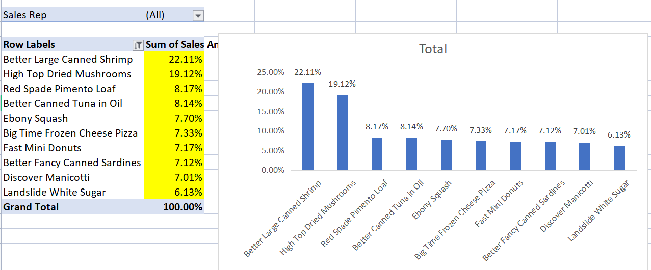
Top 10 Items in Sales:

Slide 5
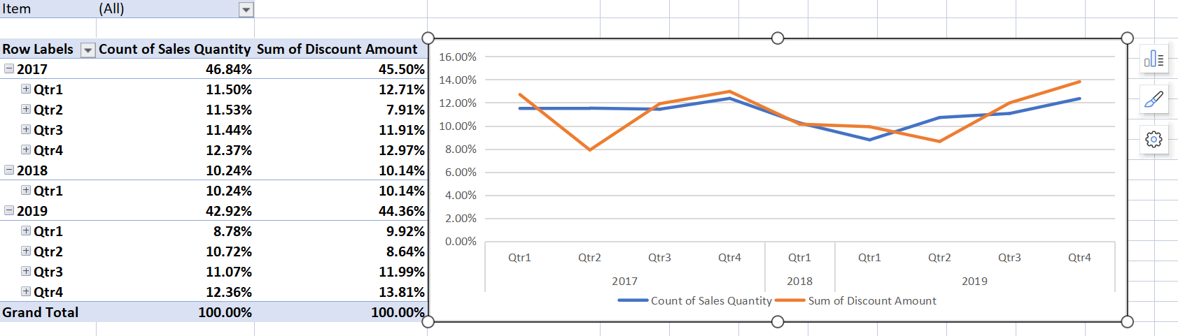
2. Sales Amount Vs Discount Amount

Slide 6
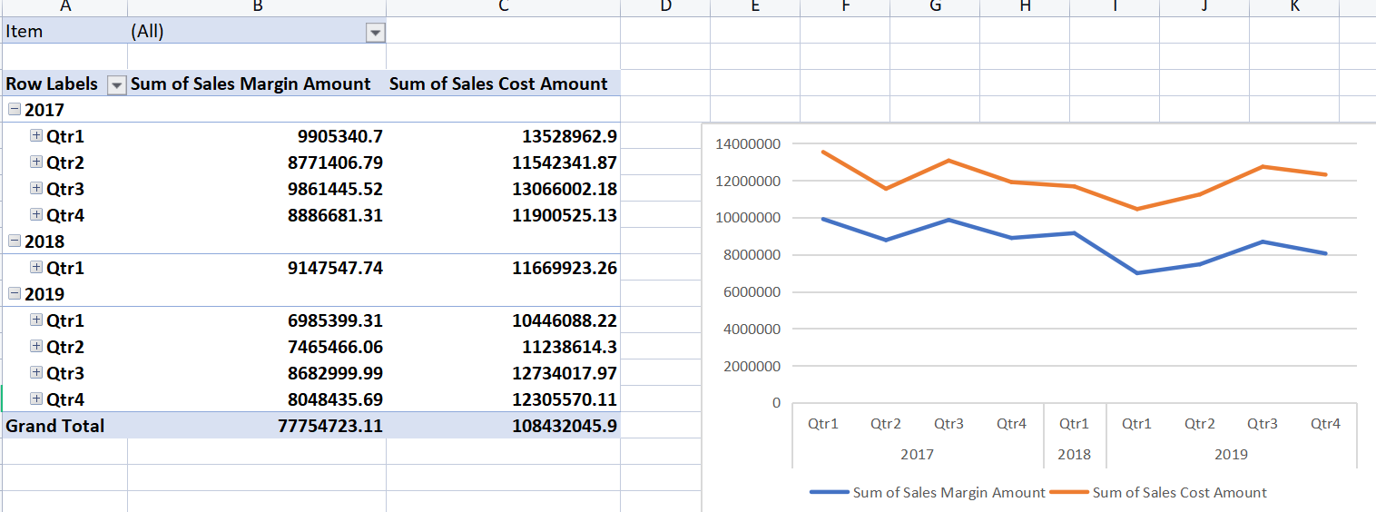
3. Margin Amount Vs Cost Amount

Slide 7
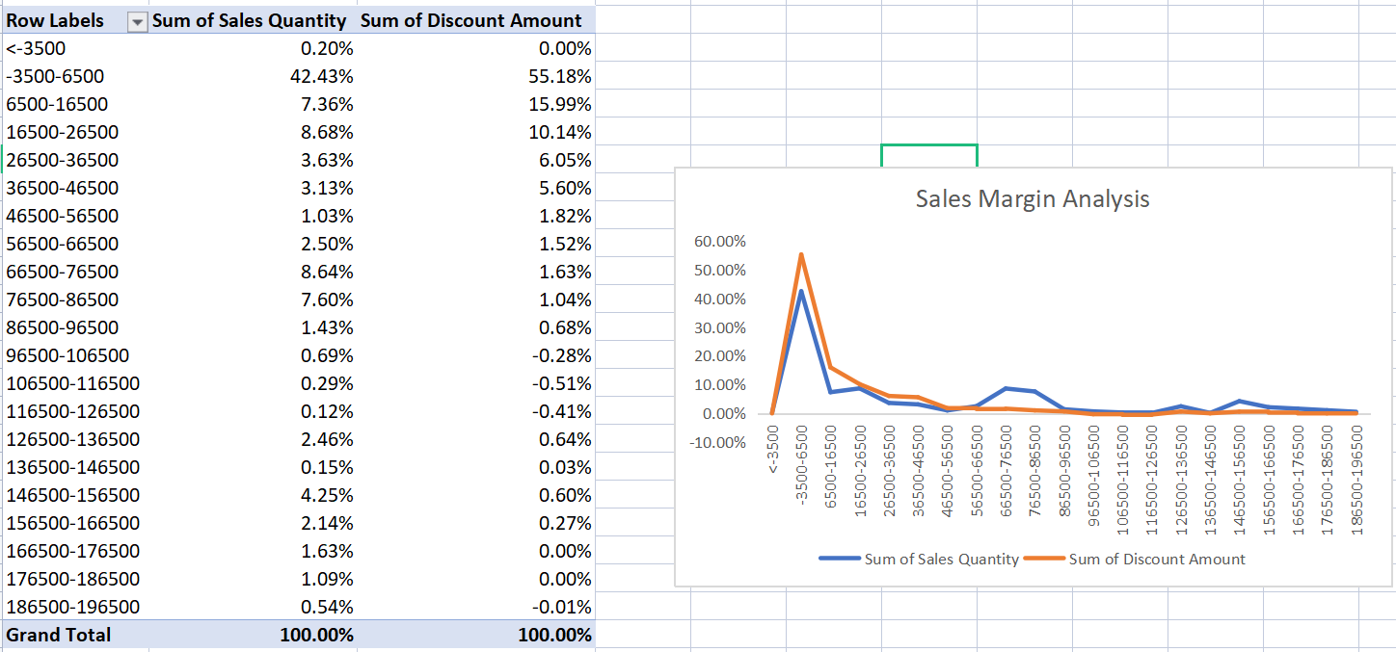
4.Sales Margin Analysis

Slide 8
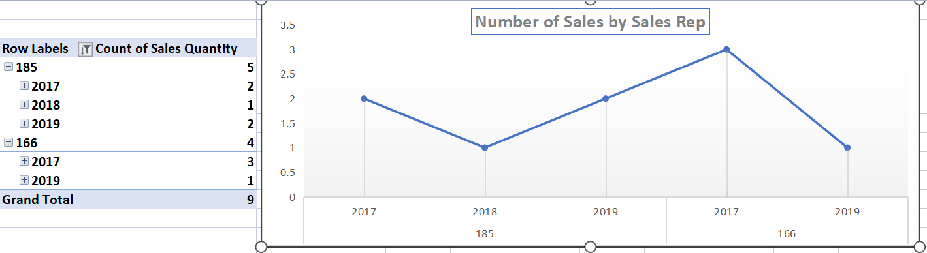
5. Number of Sales by Sales Representative

Slide 9
Thank You, Rahul Bhanushali

